Slide 1
Linear Equations
S.J.Hahn

Slide 2
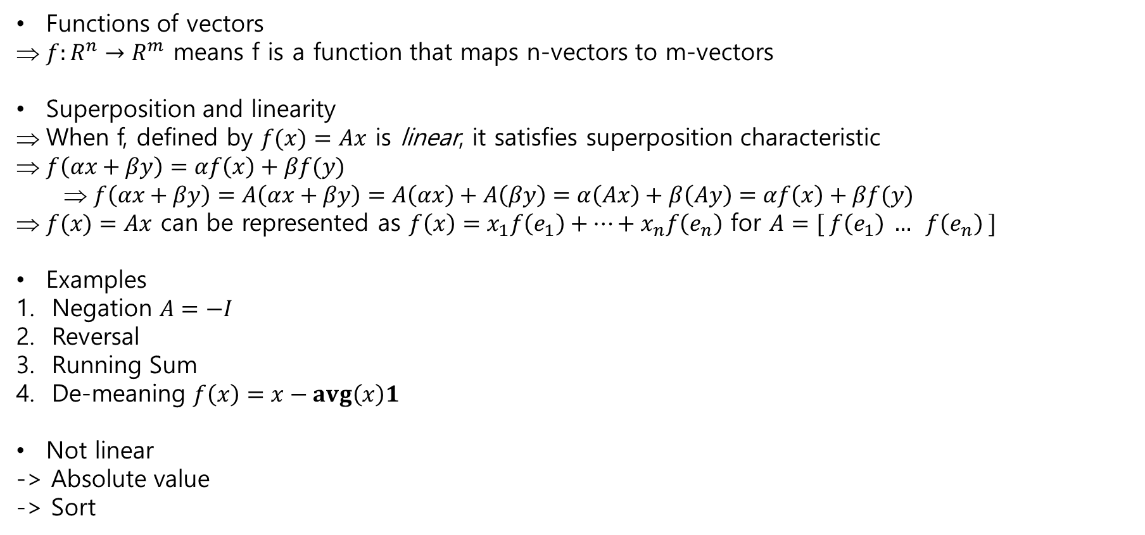
Linear and affine functions
Functions of vectors
$f:R^{n}→R^{m}$ means f is a function that maps n-vectors to m-vectors
Superposition and linearity
When f, defined by $f(x)=Ax$ is linear, it satisfies superposition characteristic
$f\left(αx+βy\right)=αf\left(x\right)+βf(y)$
$f\left(αx+βy\right)=A\left(αx+βy\right)=A\left(αx\right)+A\left(βy\right)=α\left(Ax\right)+β\left(Ay\right)=αf\left(x\right)+βf(y)$
$f(x)=Ax$ can be represented as $f\left(x\right)=x_{1}f\left(e_{1}\right)+…+x_{n}f\left(e_{n}\right)$ for $A=[ f\left(e_{1}\right) … f\left(e_{n}\right) ]$
Examples
Negation $A=−I$
Reversal
Running Sum
De-meaning $f\left(x\right)=x−avg\left(x\right)1$
Not linear
-> Absolute value
-> Sort

Slide 3
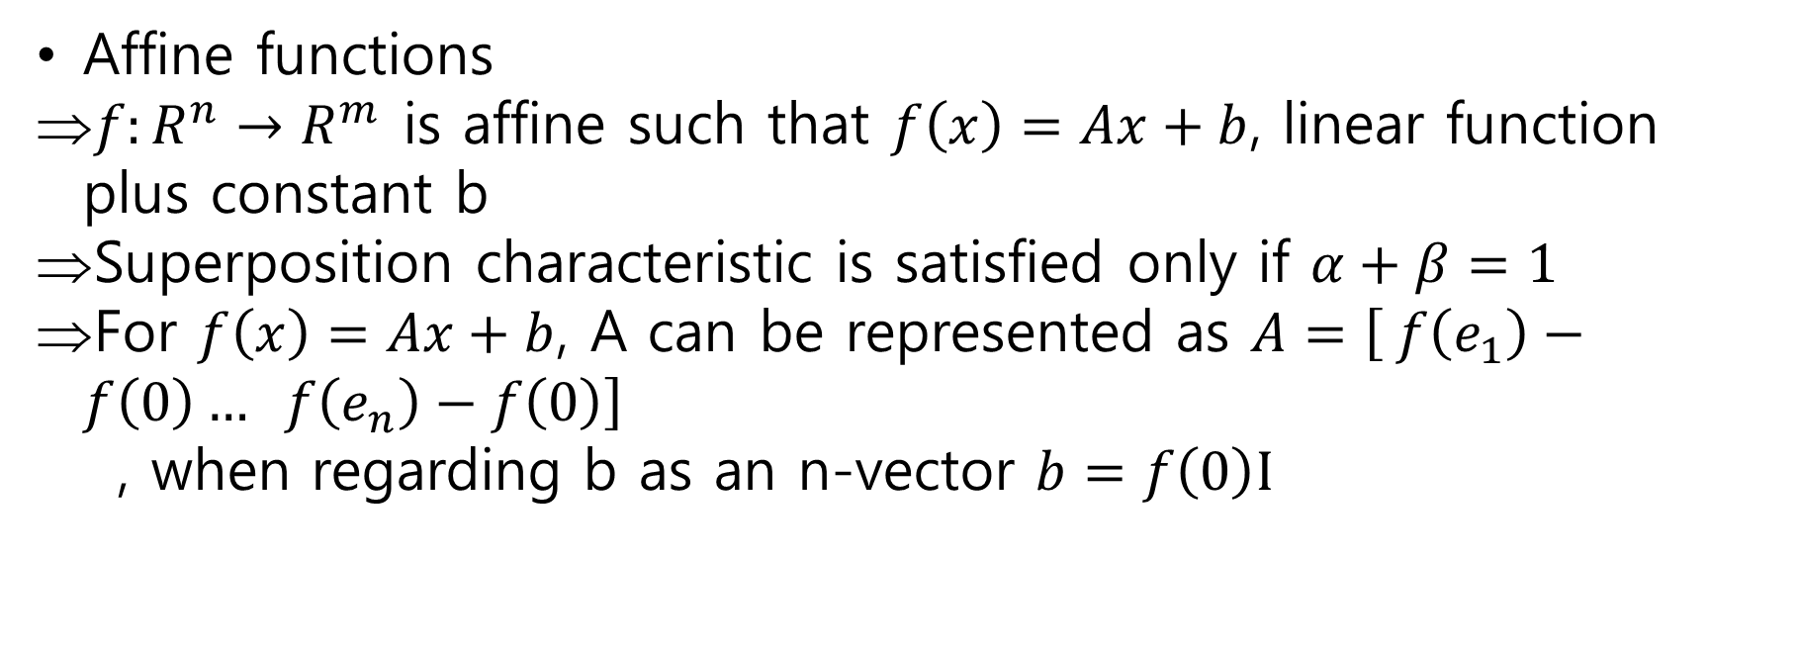
Linear and affine functions
Affine functions
$f:R^{n}→R^{m}$ is affine such that $f\left(x\right)=Ax+b$, linear function plus constant b
Superposition characteristic is satisfied only if $α+β=1$
For $f\left(x\right)=Ax+b$, A can be represented as $A=\left[ f\left(e_{1}\right)−f\left(0\right)… f\left(e_{n}\right)−f\left(0\right)\right]$
, when regarding b as an n-vector $b=f\left(0\right)I$

Slide 4
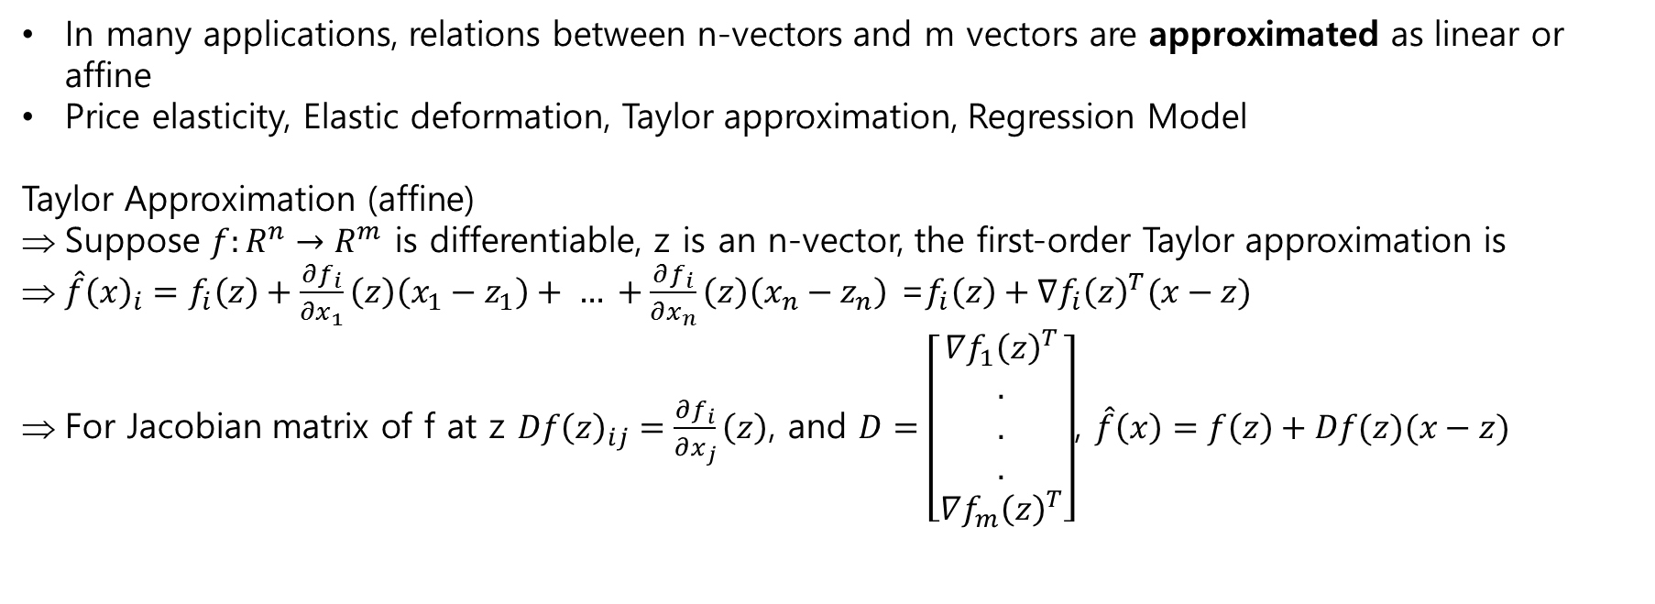
Linear function models
In many applications, relations between n-vectors and m vectors are approximated as linear or affine
Price elasticity, Elastic deformation, Taylor approximation, Regression Model
Taylor Approximation (affine)
Suppose $f:R^{n}→R^{m}$ is differentiable, z is an n-vector, the first-order Taylor approximation is
$\hat{f}{\left(x\right)}_{i}=f_{i}\left(z\right)+\frac{∂f_{i}}{∂x_{1}}\left(z\right)\left(x_{1}−z_{1}\right)+ … +\frac{∂f_{i}}{∂x_{n}}\left(z\right)\left(x_{n}−z_{n}\right)$ =$f_{i}\left(z\right)+∇f_{i}{\left(z\right)}^{T}(x−z)$
For Jacobian matrix of f at z $Df{\left(z\right)}_{ij}=\frac{∂f_{i}}{∂x_{j}}\left(z\right)$, and $D=\left[\begin{aligned}∇f_{1}{\left(z\right)}^{T} \\ . \\ . \\ . \\ ∇f_{m}{\left(z\right)}^{T}\end{aligned}\right]$, $\hat{f}\left(x\right)=f\left(z\right)+Df(z)(x−z)$

Slide 5
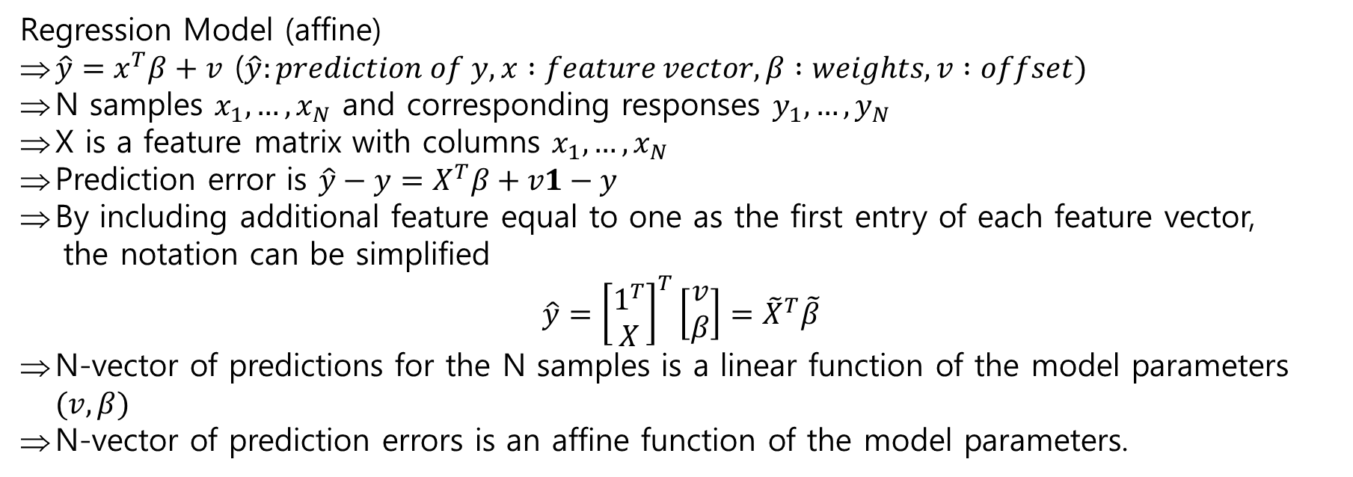
Linear function models
Regression Model (affine)
$\hat{y}=x^{T}β+v$ ($\hat{y}:prediction of y, x :feature vector, β :weights, v :offset)$
N samples $x_{1}, …, x_{N}$ and corresponding responses $y_{1}, …, y_{N}$
X is a feature matrix with columns $x_{1}, …, x_{N}$
Prediction error is $\hat{y}−y=X^{T}β+v1−y$
By including additional feature equal to one as the first entry of each feature vector,
the notation can be simplified
$$\hat{y}={\left[\begin{aligned}1^{T} \\ X\end{aligned}\right]}^{T}\left[\begin{aligned}v \\ β\end{aligned}\right]={\tilde{X}}^{T}\tilde{β}$$
N-vector of predictions for the N samples is a linear function of the model parameters $(v,β)$
N-vector of prediction errors is an affine function of the model parameters.

Slide 6
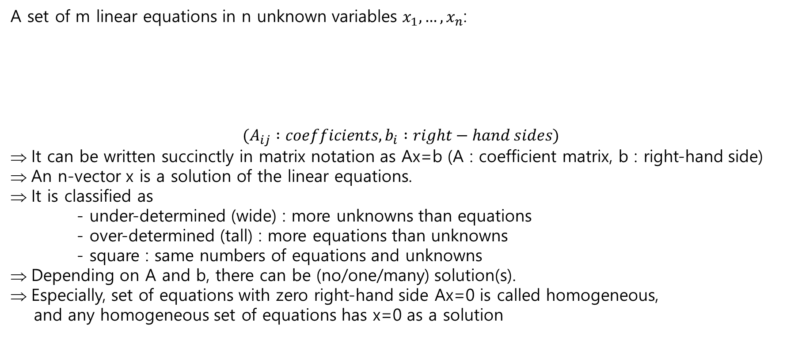
Systems of linear functions
A set of m linear equations in n unknown variables $x_{1}, …, x_{n}$:
$$(A_{ij} :coefficients, b_{i} :right−hand sides)$$
It can be written succinctly in matrix notation as Ax=b (A : coefficient matrix, b : right-hand side)
An n-vector x is a solution of the linear equations.
It is classified as
- under-determined (wide) : more unknowns than equations
- over-determined (tall) : more equations than unknowns
- square : same numbers of equations and unknowns
Depending on A and b, there can be (no/one/many) solution(s).
Especially, set of equations with zero right-hand side Ax=0 is called homogeneous,
and any homogeneous set of equations has x=0 as a solution

